Slide 1

Car Accident Severity Report

Slide 2

Introduction
Accidents in traffic lead to associated fatalities and economic losses every year worldwide and thus is an area of primary concern to society from loss prevention point of view. Modeling accident severity prediction and improving the model are critical to the effective performance of road traffic systems for improved safety.

Slide 3
Predicting accident severity is valuable
Identifing the conditions that can cause future car accidents in order to alarm the people with anticipation to be aware and drive more carefully.
The avoid of accidents will result in multiples benefits:
Save lives as main benefit
Reduce costs in damage infrastructure
Reduce cost from police and paramedics to attend each accident

Slide 4
Data Understanding
The data was collected by the Seattle Police Department and Accident Traffic Records Department from 2004 to present.
The data consists of 37 independent variables and 194,673 rows. The dependent variable, “SEVERITYCODE”, contains numbers that correspond to different levels of severity caused by an accident from 0 to 4.
Severity codes are as follows:
0: Little to no Probability (Clear Conditions)
1: Very Low Probability — Chance or Property Damage
2: Low Probability — Chance of Injury
3: Mild Probability — Chance of Serious Injury
4: High Probability — Chance of Fatality
Furthermore, because of the existence of null values in some records, the data needs to be preprocessed before any further processing.

Slide 5
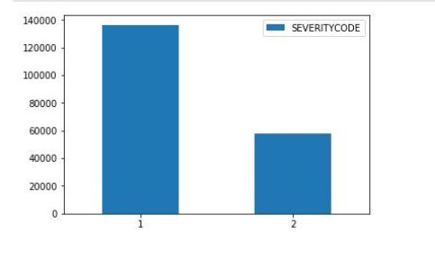
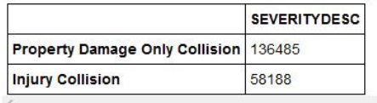


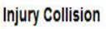
More accidents end up in property destruction as compared to physical injury

Slide 6
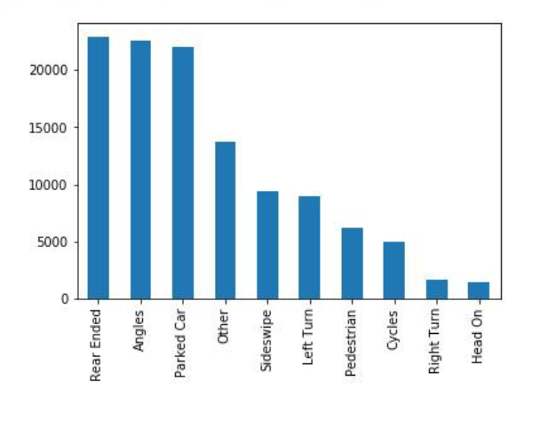

Distribution Based on Collision Type

Slide 7
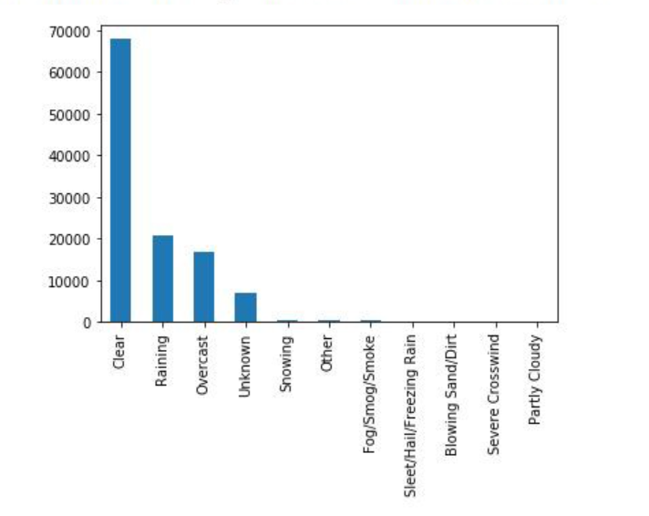
Distribution Based on Weather

Slide 8
Conclusion
Built useful models to predict whether and to what extent an accident can occur.
Accuracy of the model has room for improvement.
Most crashes happened in clear, dry, and bright conditions. Most days are clear, dry, and bright, so it’s no surprise that most car crashes occur under these conditions. I also found out that crashes with a distracted driver or an impaired driver are statistically more likely to result in injury, which is also not a surprise. The results of the data indicate to city officials that they should ask drivers to be more alert in ideal conditions.

